Slide 1
Pathfinder Player Tool
Models and Design
David Cindric
Matthew Johnson
02, October 2014
Slide 1

Slide 2
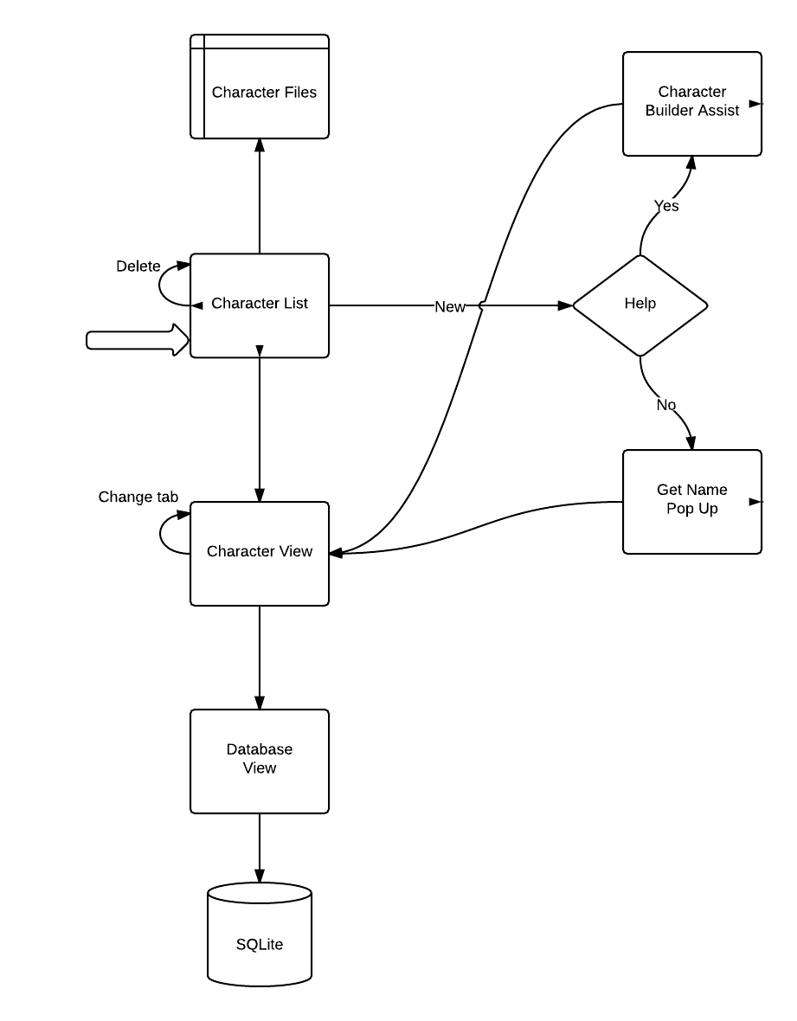
Process Model
Start
Slide 2

Slide 3
Data Model
Slide 4

Slide 4
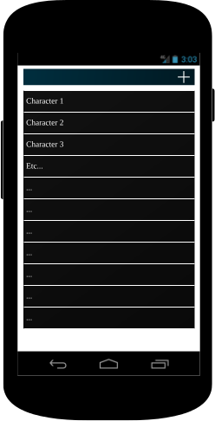
Main Screen
Slide 5

Slide 5
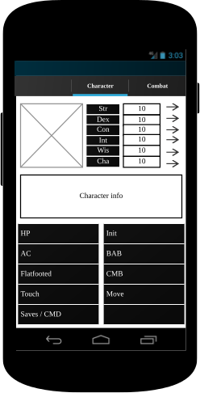
Character
Slide 6

Slide 6
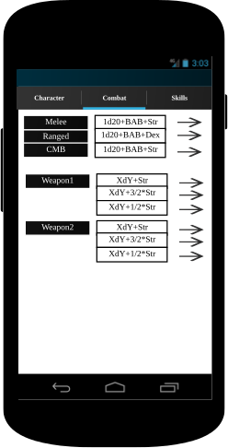
Combat
Slide 7

Slide 7
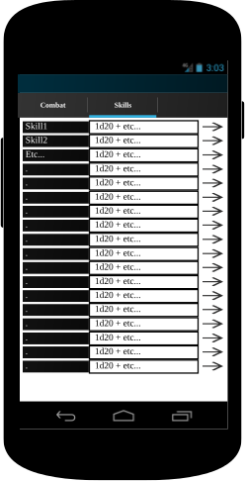
Skills
Slide 8

